Slide 1




Learning Model for conquering ML-DL-AI-OpenCV-IoT Roadblocks
Shashank S. Sahoo

Slide 2
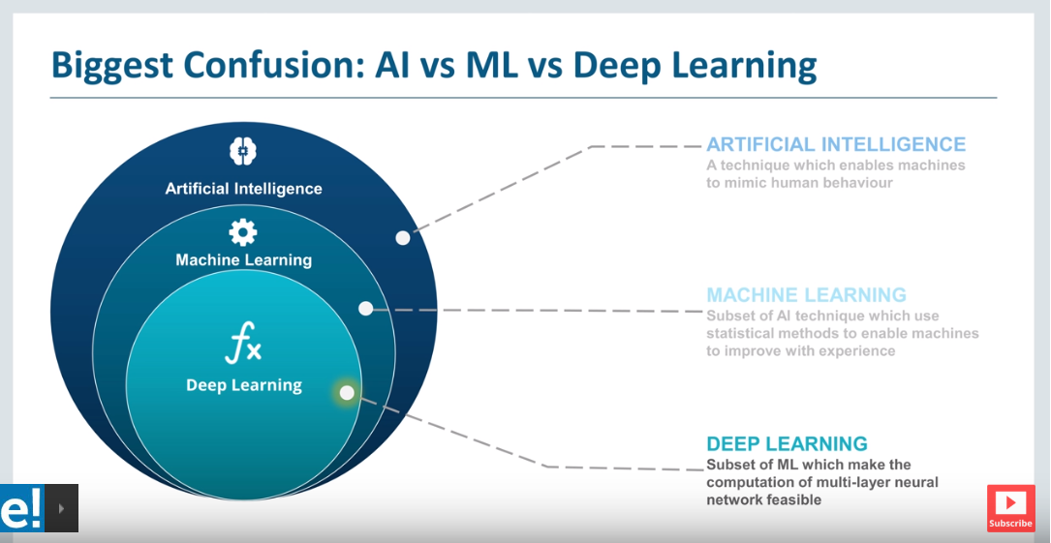
Confused ??

Slide 3
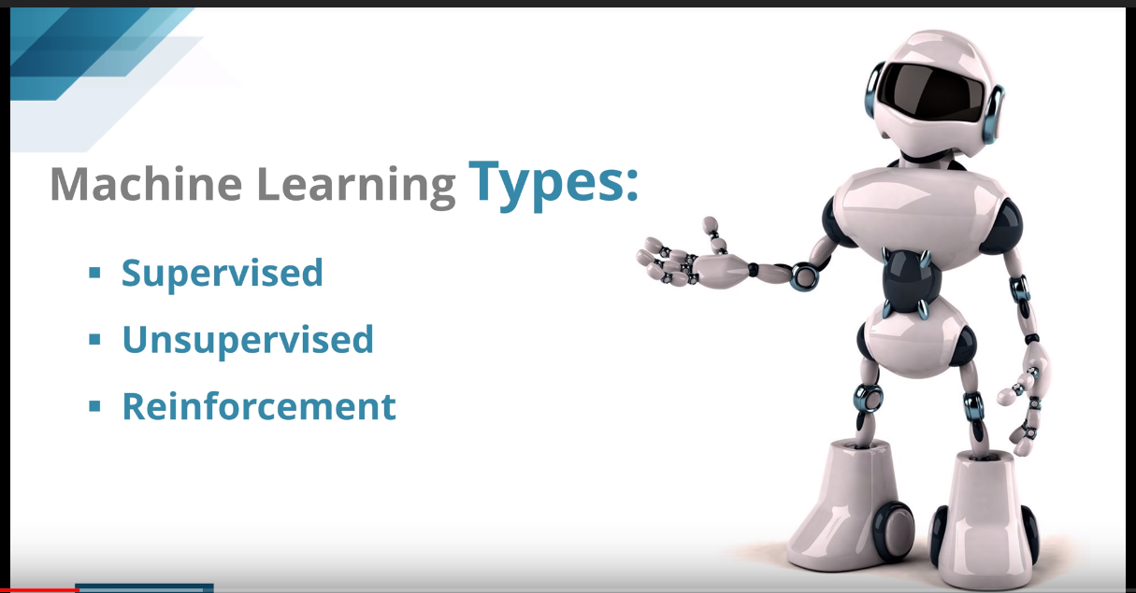

Slide 4
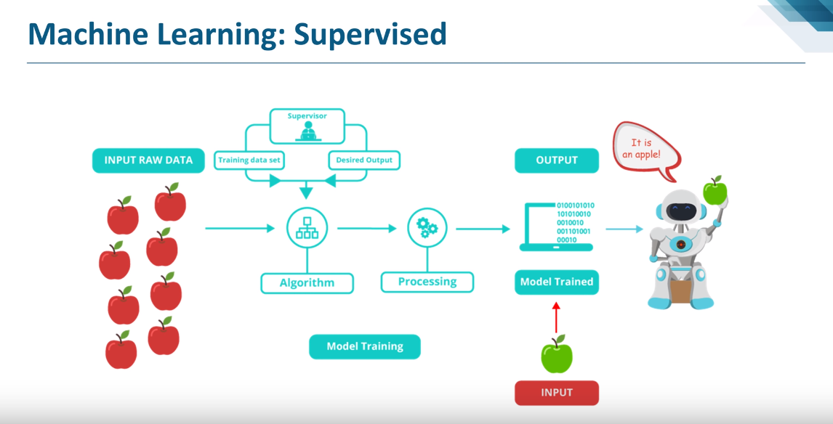

Slide 5
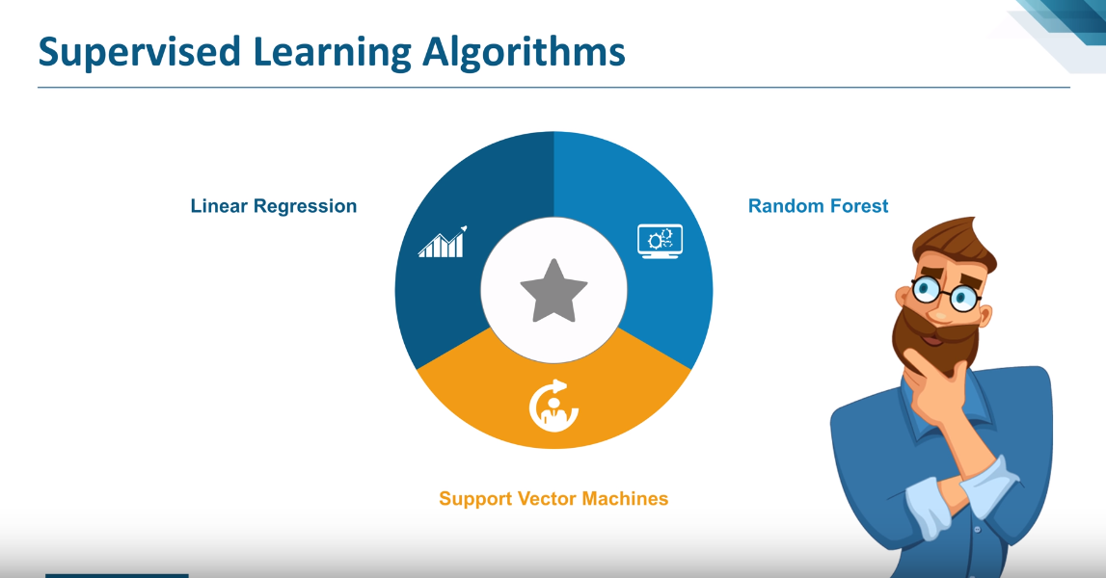

Slide 6
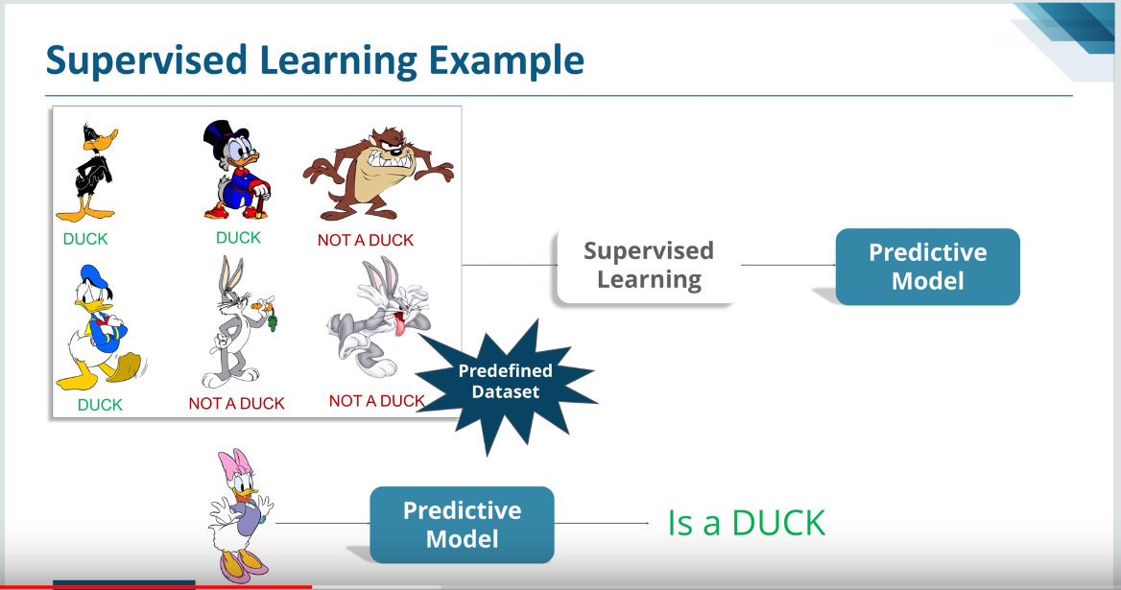

Slide 7
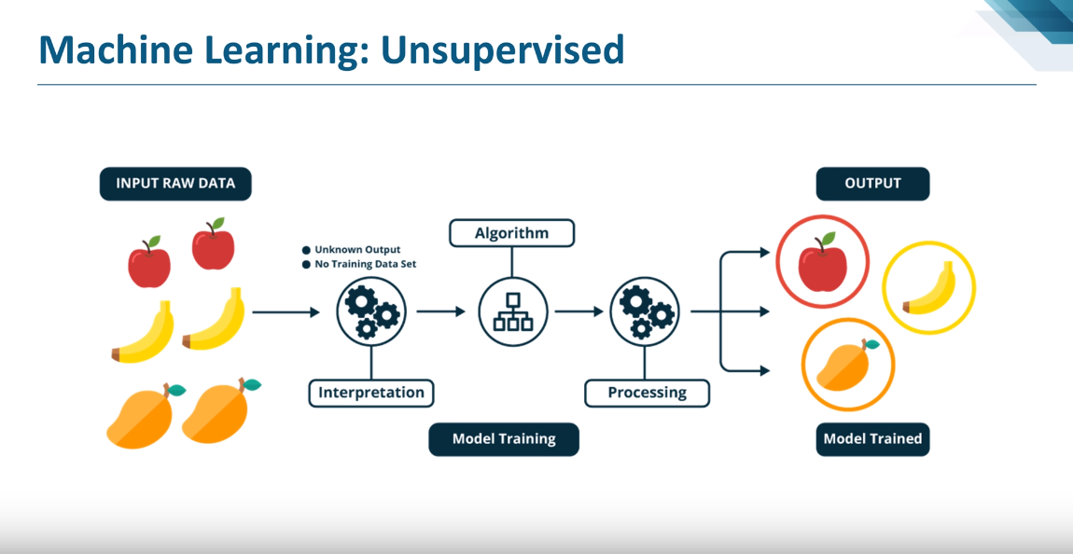

Slide 8
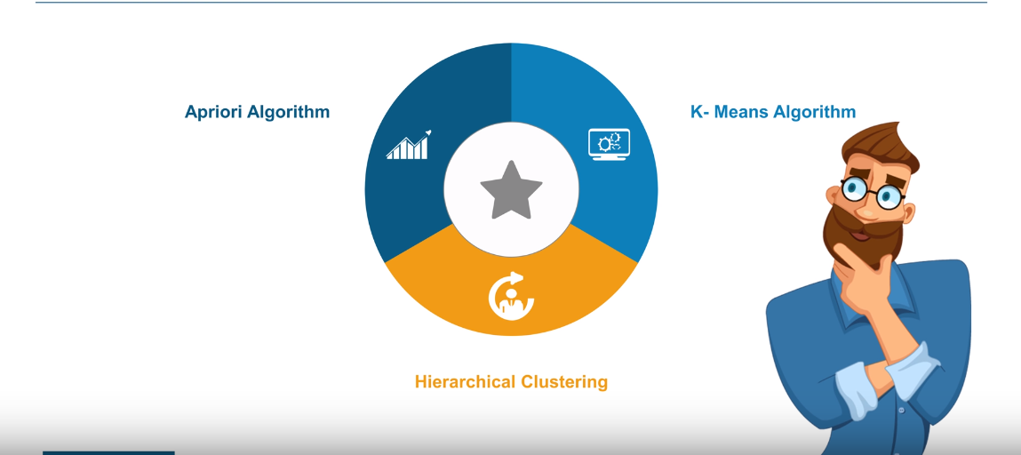
Unsupervised Machine Learning Algorithms

Slide 9
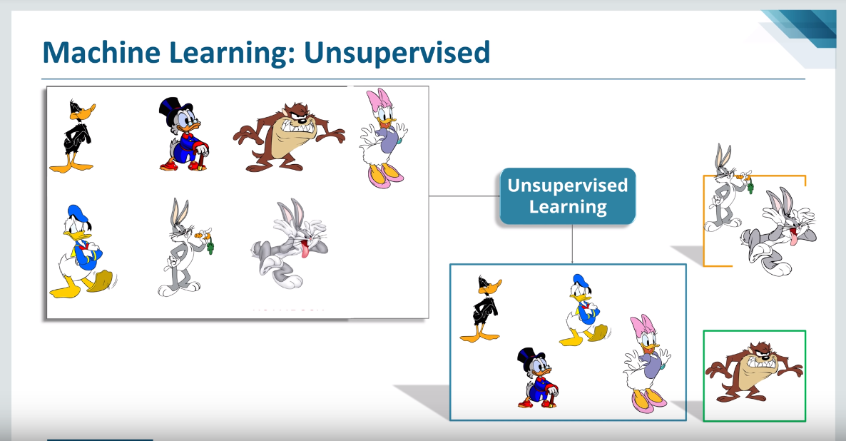

Slide 10
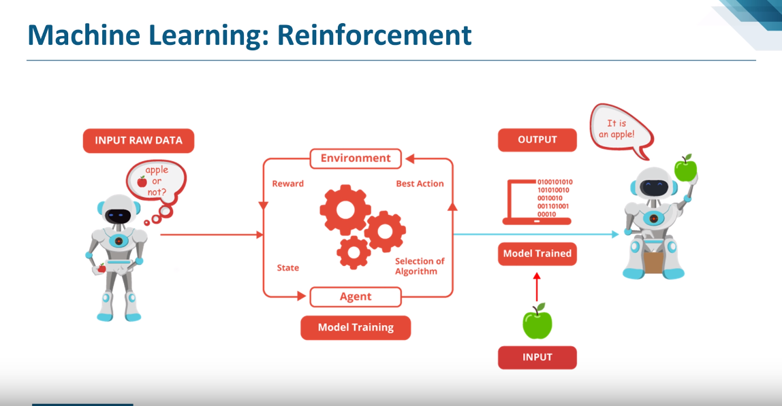

Slide 11
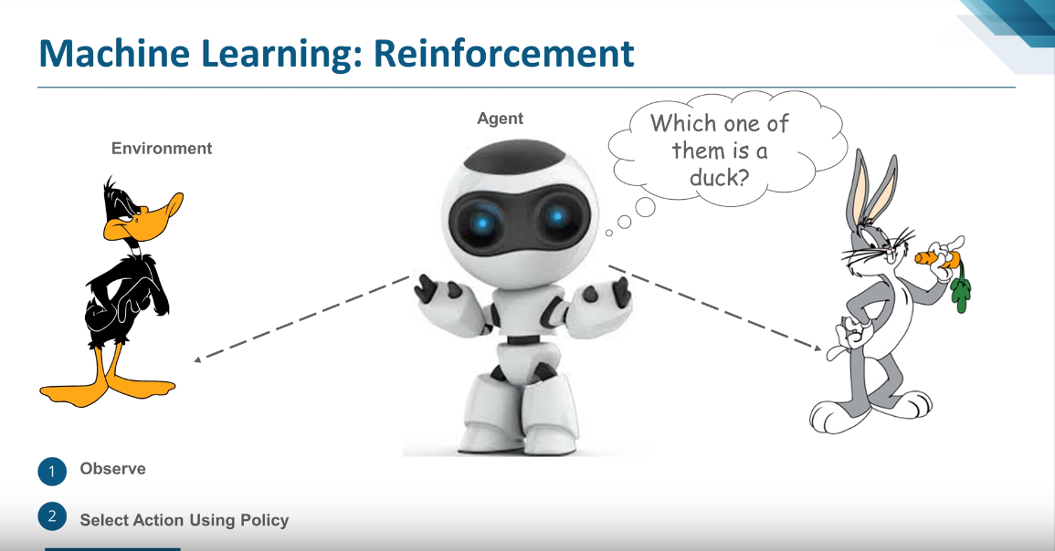

Slide 12
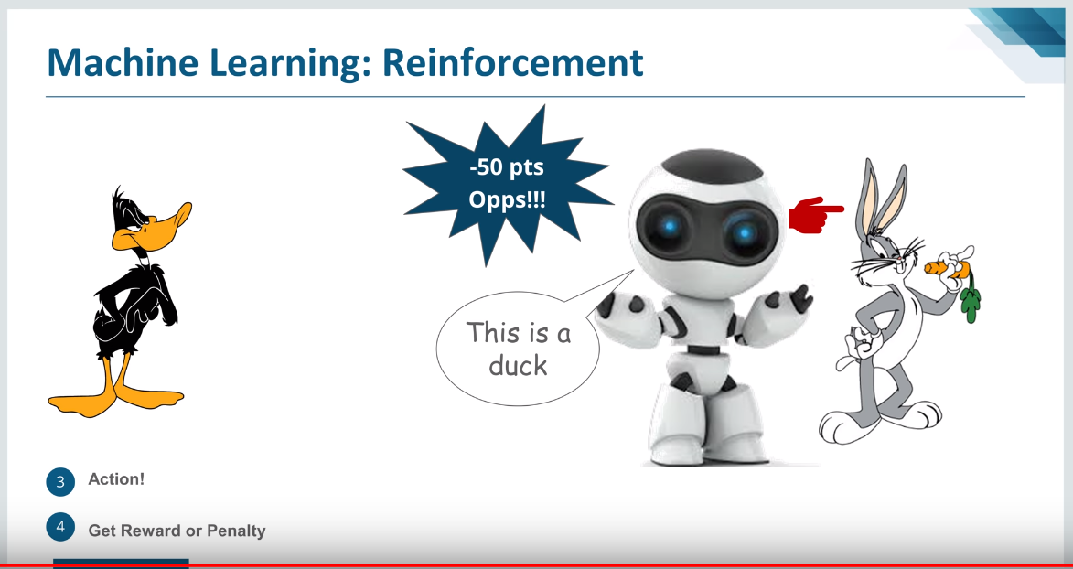

Slide 13
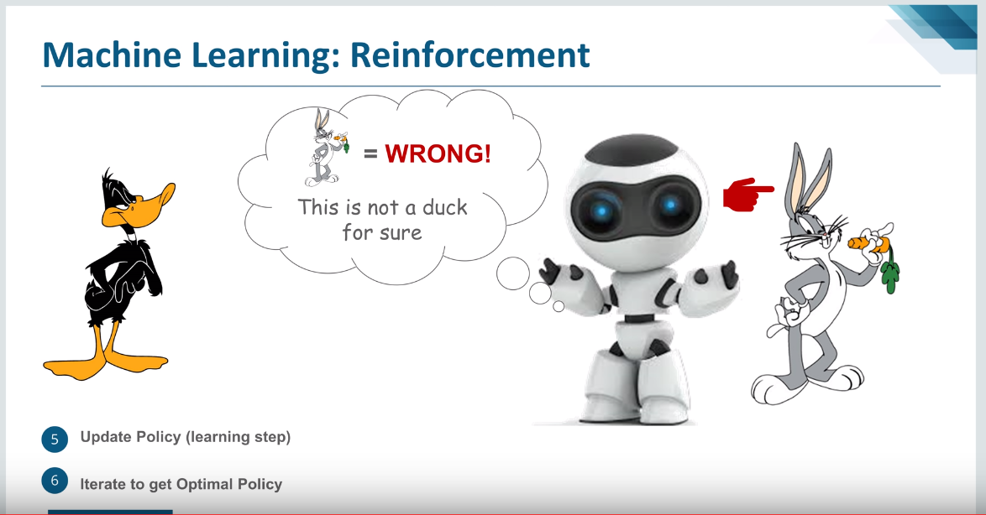

Slide 14
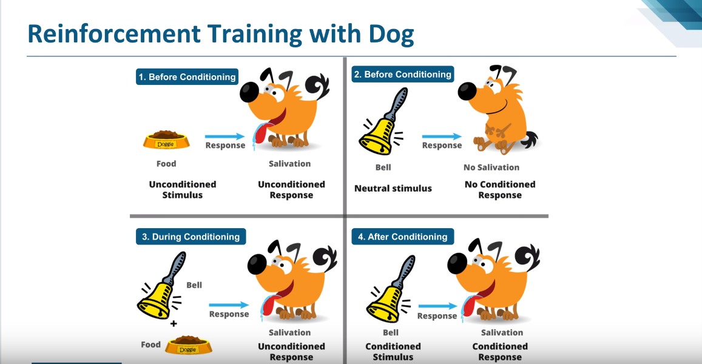

Slide 15
Classical Regression Problems – Predicting continuous or real-valued output
Predicting prices of house based on floor size.
Predicting age of person based on height.
Predicting number of sales unit based on market campaigns and online advertisement data features.

Slide 16
Classical Classification Problems – Predicting discrete valued output
Predicting an email is spam or not-spam.
Predicting whether a candidate will default on loan or not.
Predicting whether a cancer tumor is malign or benign.

Slide 17
Classical Clustering Problems – Grouping different patterns/ types/ varieties/ groups in unstructured data
Automatically grouping together the different types of news from internet into different buckets.
Social Network Analysis
Organize Computing Clusters
Market Segmentation
Astronomical data analysis
Multi-sound recognition and classification from a super-imposed audio signal with noise tolerance into separating buckets.

Slide 18
Seaborn
sns.pairplot(df_xxxxxxxx)
sns.distplot(df_xxxxxxx[‘yyyyyyy’])
sns.heatmap(df_titanic.isnull(),yticklabels=False,cbar=False,cmap='viridis’)
sns.heatmap(df_boston.corr(),annot=False)
sns.distplot(y_test-predictions)
sns.set_style('whitegrid’)
sns.countplot(x='Survived',data=train,palette='RdBu_r’)
sns.set_style('whitegrid')
sns.countplot(x='Survived',hue='Sex',data=train,palette='RdBu_r’)
sns.jointplot(x='Age',y='Daily Time Spent on Site',data=ad_data,color='red',kind='kde’);
corr_starwars.dropna(inplace=True)
Notes:
When conducting research, it is easy to go to one source: Wikipedia. However, you need to include a variety of sources in your research. Consider the following sources:
Who can I interview to get more information on the topic?
Is the topic current and will it be relevant to my audience?
What articles, blogs, and magazines may have something related to my topic?
Is there a YouTube video on the topic? If so, what is it about?
What images can I find related to the topic?

Slide 19
Steps of Data Science and Machine Learning
Import the required Dataset in .CSV(preferably) format.
Transform the Data in dataset into Pandas DataFrames( Tabular representation)
Exploratory Data Analysis : Analyze the data through various evaluation function and libraries to visualize the
Dataset intelligibly.
Dealing with missing values
Dealing with multi-collinearity( For Ex : male, females)
Check for possibility of feature engineering on part of columns data-value that are either in text(string) or alphanumeric.
Identify the features and targets of the ML problem.
Split the dataset into training and testing subsets( usually 8:2 )
Train the Regression or Classification model on training data.
Evaluate the model’s performance on some test data.
Create a confusion matrix to determine performance metrics of chosen model for the ML problem.
Based on predicted results, we can act on to improve the ML model.
Notes:
When conducting research, it is easy to go to one source: Wikipedia. However, you need to include a variety of sources in your research. Consider the following sources:
Who can I interview to get more information on the topic?
Is the topic current and will it be relevant to my audience?
What articles, blogs, and magazines may have something related to my topic?
Is there a YouTube video on the topic? If so, what is it about?
What images can I find related to the topic?

Slide 20
SML – Linear Regression Algorithm
Linear regression is a kind of statistical analysis that attempts to show a relationship between two variables. Linear regression looks at various data points and plots a trend line. Linear regression can create a predictive model on apparently random data, showing trends in data, such as in cancer diagnoses or in stock prices.
Regression Phenomena : A father’s son’s height tends to regress( drift towards) the average(mean) height.
Notes:
When conducting research, it is easy to go to one source: Wikipedia. However, you need to include a variety of sources in your research. Consider the following sources:
Who can I interview to get more information on the topic?
Is the topic current and will it be relevant to my audience?
What articles, blogs, and magazines may have something related to my topic?
Is there a YouTube video on the topic? If so, what is it about?
What images can I find related to the topic?

Slide 21
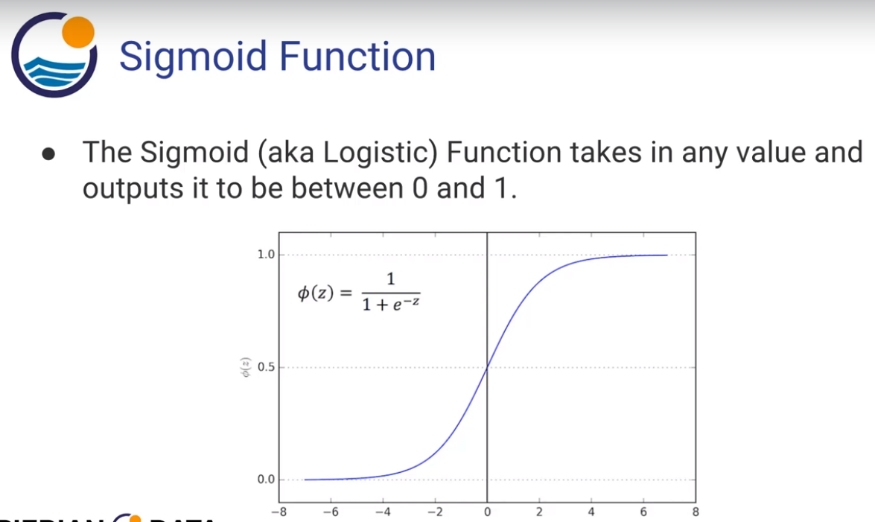
SML – Logistic Regression Algorithm
Mainly used for classical Binary classification problems like :
Spam versus “Ham” emails
Loan Default (yes/no)
Disease Diagnosis
It uses a logistic Regression Curve – a sigmoid function ( outputs value between 0 and 1)
Notes:
When conducting research, it is easy to go to one source: Wikipedia. However, you need to include a variety of sources in your research. Consider the following sources:
Who can I interview to get more information on the topic?
Is the topic current and will it be relevant to my audience?
What articles, blogs, and magazines may have something related to my topic?
Is there a YouTube video on the topic? If so, what is it about?
What images can I find related to the topic?

Slide 22
SML – K-NN(Nearest Neighbor) Algorithm
Training Algorithm :
Store all the Data
Prediction Algorithm :
Calculate the distance from x to all points in your data.
Sort the points in your data by increasing distance from x.
Predict the majority label of the “k” closest points.
Notes:
When conducting research, it is easy to go to one source: Wikipedia. However, you need to include a variety of sources in your research. Consider the following sources:
Who can I interview to get more information on the topic?
Is the topic current and will it be relevant to my audience?
What articles, blogs, and magazines may have something related to my topic?
Is there a YouTube video on the topic? If so, what is it about?
What images can I find related to the topic?

Slide 23
SML – Decision Tree & Random Forest Algorithm
Nodes : Split for the value of a certain attribute
Edges : Outcome of a split to next node
Root : The node that performs the first split.
Leaves : Terminal nodes that predict the outcome.
Notes:
When conducting research, it is easy to go to one source: Wikipedia. However, you need to include a variety of sources in your research. Consider the following sources:
Who can I interview to get more information on the topic?
Is the topic current and will it be relevant to my audience?
What articles, blogs, and magazines may have something related to my topic?
Is there a YouTube video on the topic? If so, what is it about?
What images can I find related to the topic?

Slide 24
SML – SVM( Support Vector Machine ) Algorithm
Support Vector machines (SVMs) are supervised learning models with associated learning algorithms that analyze data and recognize patterns, used for classification and regression analysis.
Notes:
When conducting research, it is easy to go to one source: Wikipedia. However, you need to include a variety of sources in your research. Consider the following sources:
Who can I interview to get more information on the topic?
Is the topic current and will it be relevant to my audience?
What articles, blogs, and magazines may have something related to my topic?
Is there a YouTube video on the topic? If so, what is it about?
What images can I find related to the topic?

Slide 25
Amazon AWS
Notes:
When conducting research, it is easy to go to one source: Wikipedia. However, you need to include a variety of sources in your research. Consider the following sources:
Who can I interview to get more information on the topic?
Is the topic current and will it be relevant to my audience?
What articles, blogs, and magazines may have something related to my topic?
Is there a YouTube video on the topic? If so, what is it about?
What images can I find related to the topic?

Slide 26
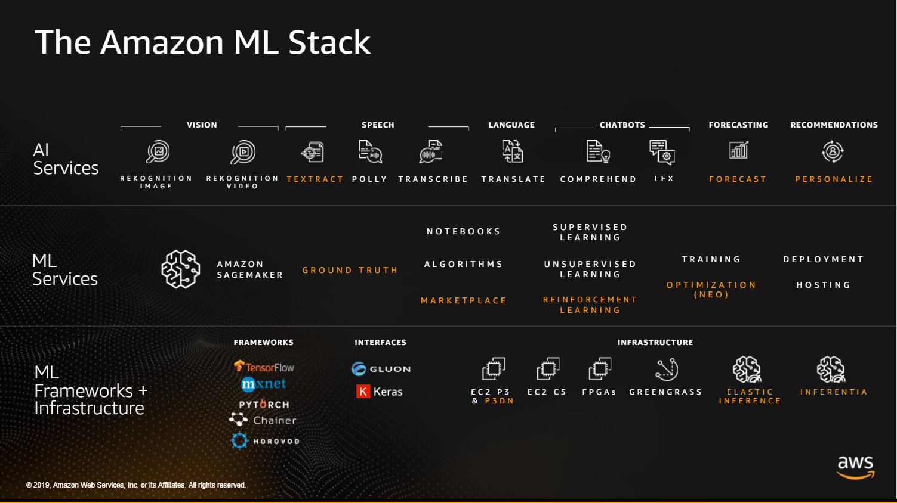

Slide 27

Evaluate Your Sources
Refer to the notes section below for guidelines on this topic.
Notes:
Once you find your sources, you will want to evaluate your sources using the following questions:
Author:
Who is the author?
Why should I believe what he or she has to say on the topic?
Is the author seen as an expert on the topic? How do you know?
Current:
How current is the information in the source?
When was the source published?
Is the information out-of-date?
Accuracy:
Is the content accurate?
Is the information presented objectively? Do they share the pros and cons?

Slide 28
Narrow Your Topic
Refer to the notes section below for guidelines on this topic.
Notes:
After consulting a variety of sources, you will need to narrow your topic. For example, the topic of internet safety is huge, but you could narrow that topic to include internet safety in regards to social media apps that teenagers are using heavily. A topic like that is more specific and will be relevant to your peers. Some questions to think about to help you narrow your topic:
What topics of the research interest me the most?
What topics of the research will interest my audience the most?
What topics will the audience find more engaging? Shocking? Inspiring?

Slide 29
Organize Your Research
Refer to the notes section below for guidelines on this topic.
Notes:
Now, that you have narrowed your topic, you will want to organize your research in a structure that works. There are some common organizational patterns based on the kind of research you are doing.
Organizational Structures:
Cause and Effect- this kind of structure is great for explaining the causes and effects of a topic
Compare and Contrast- in this pattern you highlight the similarities and differences of the topic
Explain process- this structure is great for outlining a series of steps to follow;
Definition- if you want to make sure your audience understands what something is using illustrations, meanings, clarifying misconceptions, you may want to use this structure
Classification- a common organizational structure is grouping like topics or facts from the research together. For instance, in the internet safety about social media apps, you may organize the research where you look at each social media app one at a time

Slide 30
Present Your Research
Refer to the notes section below for guidelines on this topic.
Notes:
After you’ve done your research, it’s time to put your presentation together. The first step in the process is to introduce the topic. This is a great time to connect your topic to something that your audience can relate. In other words, why should they listen to all the information you will be sharing in your research presentation? What is in it for them? You may also want to include a graphic or image to grab their attention.
Feel free to duplicate this slide by right-clicking on this slide in the slides pane to the left and select Duplicate Slide.
The next step in your presentation is to state your claim or topic clearly. Your teacher may even call this your thesis. As you state your thesis, you may find that this layout is not the best layout for your claim or topic. You can change the layout by clicking the drop-down menu next to the Layout in the Slides menu section. You can choose Two Content, Comparison, or Picture with Caption. Note: A different layout might change the look of the icons on this page.
You will also want to state your facts. You have done the research now share some of the interesting facts with your audience. Facts do not have to be boring; you can communicate facts in a variety of ways by going to the Insert Tab. In the Insert tab you can:
Insert pictures from your computer or online.
Add a chart
Create some SmartArt
Insert a variety of icons to help your facts come to life. Note: You can change the color of the icons by selecting the icon and then click on the Format tab and then Graphics Fill. From there, you will choose a color from the list or choose More Fill Colors to give you more options.
Since this research presentation is a result of your hard work and searching, you want to make sure you support the claims or points in your presentation with facts from your research findings. Make sure you give the author proper credit for helping you share your ideas. If one of your sources has a video that is relevant to your topic, you can add the video as added support. Keep in mind the length of the video and the amount of time you have for your presentation. For a 5 minute speech, the video should be no longer than 30 seconds.
Questions to consider:
How will you state the author of the source?
Will you need to cite the source on the slide?
What are some ways you can engage your audience so they feel like they are a part of the presentation? Some ideas to consider is by taking a quick poll like: by a show of hands, how many of you think school uniforms are a way to cut down on bullying? Another suggestion is to have them hold up a certain number of fingers to see if they agree or disagree. Finally, you can share a story that the audience can relate to that makes them laugh.
After all the applause, your audience may have some questions. Be prepared to answer some of their questions by making a list of questions you think they might ask. You may also want to share the presentation with them by providing the link to your presentation, if they want more information.

Slide 31
Research Presentation
Notes:
You can use this slide as your opening or closing slide. Should you choose to use it as a closing, make sure you review the main points of your presentation. One creative way to do that is by adding animations to the various graphics on a slide. This slide has 4 different graphics, and, when you view the slideshow, you will see that you can click to reveal the next graphic. Similarly, as you review the main topics in your presentation, you may want each point to show up when you are addressing that topic.
Add animation to images and graphics:
Select your image or graphic.
Click on the Animations tab.
Choose from the options. The animation for this slide is “Split”. The drop-down menu in the Animation section gives even more animations you can use.
If you have multiple graphics or images, you will see a number appear next to it that notes the order of the animations.
Note: You will want to choose the animations carefully. You do not want to make your audience dizzy from your presentation.

